Slide 1

AI Governance and the AI Lifecycle
Dr. Alessio Azzutti
Lecturer in Law & Technology (FinTech)
University of Glasgow
Faculty of Law
LLM Artificial Intelligence & Law
Seminar 8
13 March 2026

Slide 2
Seminar Outline
AI Governance: An Introduction
Intra-organisational Dimension: The “AI Lifecycle”
The AI Lifecycle and Emerging AI Regulations
In-class Activity

Slide 3
Part One
AI Governance

Slide 4
Key Questions for Today
What do we mean by AI governance?
Why do we need it?
Who should be responsible for it?
Why does AI governance require an engineering understanding of AI systems?
How can technical design be aligned with regulatory standards in practice?

Slide 5
Defining AI Governance
Mäntymäki et al. (2022: 604)
“AI governance is a system of rules, practices, processes, and technological tools that are employed to ensure an organization’s use of AI technologies aligns with the organization’s strategies, objectives, and values; fulfils legal requirements; and meets principles of ethical AI followed by the organization.”

Slide 6
AI Governance Terminology
See Papagiannidis, Mikalef, & Conboy (2025)
Principled AI
Defines governance dimensions through a set of high-level principles, such as privacy, transparency, and fairness.
Responsible AI
Refers to frameworks that guide the design, development, and use of AI through multiple ethical and governance principles…
Trustworthy AI
Commonly defined through seven core principles: accountability, human agency and oversight, technical robustness and safety, privacy and data governance, transparency, fairness, and social and environmental well-being (cf. EU Commission, 2019).
How far do these labels clarify AI governance — and when do they simply become buzzwords?

Slide 7
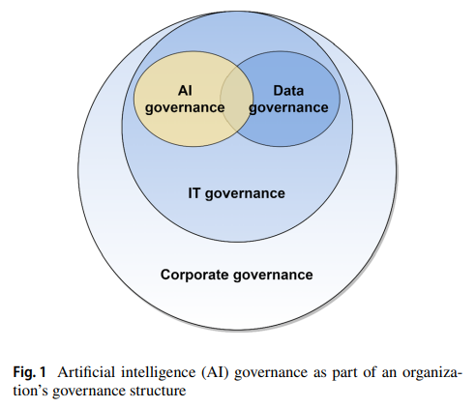
Organisational AI Governance
Mäntymäki et al. (2022: 605)
AI is the new flatmate!
And it need clear house rules.
Corporate Governance
Sets direction, accountability, and strategic alignment for AI.
IT Governance
Provides oversight of the infrastructure and technical systems behind AI.
Data Governance
Governs the quality, protection, and responsible use of AI data.

Slide 8
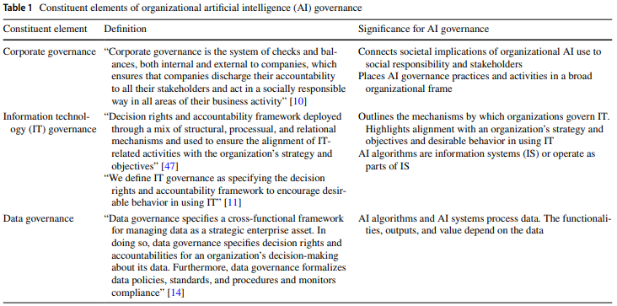
Organisational AI Governance (i)
Mäntymäki et al. (2022: 607)

Slide 9
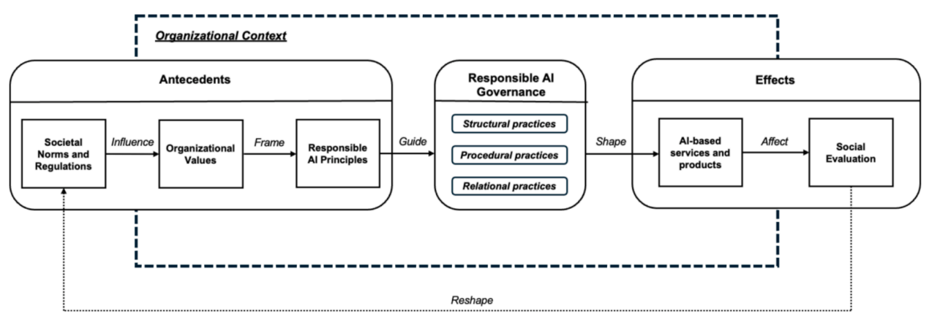
Responsible AI Governance into Context
See Papagiannidis, Mikalef, & Conboy (2025: 11)

Slide 10
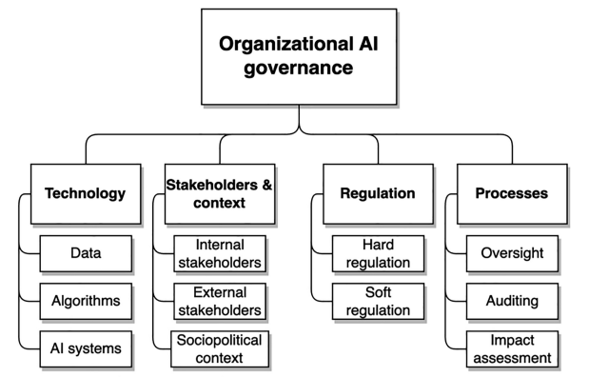
Key Themes in Organisational AI Governance
Birkstedt et al. (2023: 143-150)

Slide 11
AI Regulation Is Not All You Need?
Cf. Lucaj, van der Smagt, & Benbouzid (2023)
The “Big Issue”: Moving from Principles to Practice
Regulation matters, but it is not enough on its own.
Effective AI governance also depends on technical standards and human expertise.
Regulators often lack the specialised knowledge and capacity needed to address AI’s socio-technical complexity (cf. public regulation theory).
The private sector is often better placed to attract top AI talent and develop technical standards (cf. private regulation theory).
Within organisations, AI governance depends on internal expertise, compliance capacity, and operational best practices.
Key Challenges:
❓How can we build balanced and effective public-private collaboration?
❓How can we ensure AI ultimately advances the public good and promotes societal well-being?

Slide 12
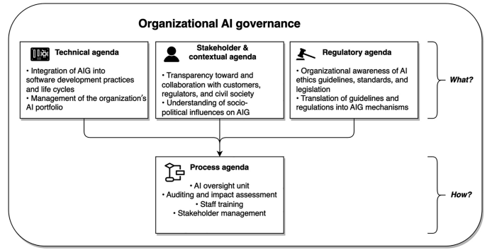
Research Agenda in AI Governance
Birkstedt et al. (2023: 155)

Slide 13

Questions?

Slide 14
Part Two
The AI Lifecycle

Slide 15
The AI Lifecycle & Its Role in AI Governance
See De Silva & Alahakoon (2022)
What is the AI Lifecycle?
Rooted in engineering and systems design, the AI lifecycle provides a holistic framework for understanding AI systems as complex socio-technical systems. It is typically structured around three main phases: (i) design, (ii) development, and (iii) deployment.
Why Does It Matter for AI Governance?
AI-specific by design – Traditional software lifecycles do not fully capture the governance needs created by AI’s autonomy, opacity, and adaptability.
Risk-based – It embeds governance across the full lifecycle, helping organisations identify and manage risks before, during, and after deployment, including privacy, cybersecurity, and explainability risks.
Bridges regulation and practice – Serves as a governance framework for both legal compliance (e.g., AI Act, GDPR) and industry self-regulation.
Supports Trustworthy AI – Facilitates accountability, transparency, human oversight, and continuous evaluation, ensuring AI systems align with ethical and regulatory expectations.

Slide 16
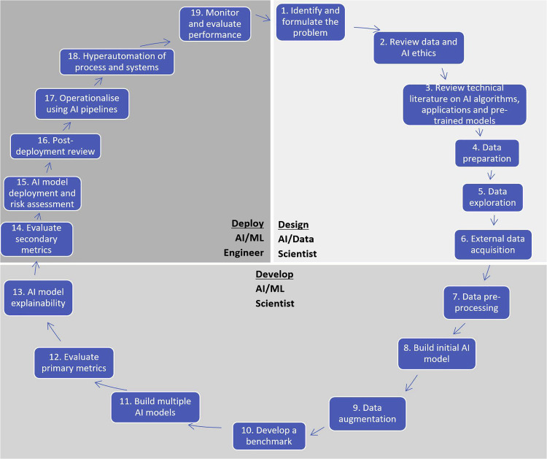
See De Silva & Alahakoon (2022)
👥 AI Lifecycle & Human Involvement
Each phase of the AI lifecycle requires specialised human expertise — from AI scientists and data engineers to compliance officers and ethicists.
The composition of AI teams depends on the size, scope, and complexity of the project. Larger initiatives may require dedicated roles in governance, risk management, and deployment.
Not all AI lifecycles are equally complex. For example, the process may be more straightforward when systems are procured from third parties rather than developed in-house.
Governance and compliance responsibilities also vary depending on whether the system is custom-built, fine-tuned, or externally sourced.

Slide 17
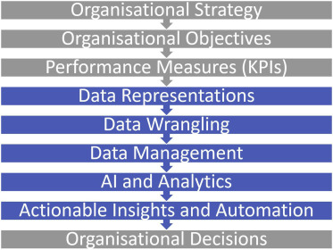
The Organisational Context of the AI Lifecycle
See De Silva & Alahakoon (2022)
The AI lifecycle operates within the wider organisational workflow, from strategic planning to operational decision-making.
AI development must be aligned with organisational objectives, ensuring that AI systems support business goals, compliance requirements, and risk management.
Effective AI governance also requires cross-functional collaboration. AI teams need to work closely with senior management, legal and compliance functions, ethicists, and end-users.
AI lifecycle
🔗 Key Takeaway: Understanding the organisational context of AI is essential for effective integration/adoption, stakeholder alignment, and responsible deployment.

Slide 18
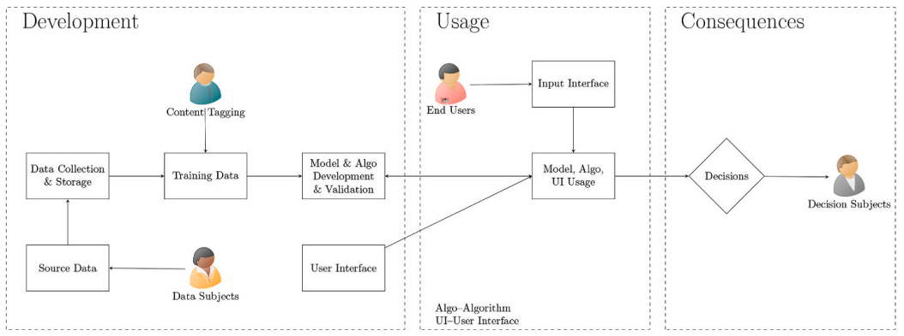




Who are the Stakeholders of an AI Project?
See Miller (2022)
In and along the lifecycle, we find both active and passive stakeholders of AI systems.

Slide 19
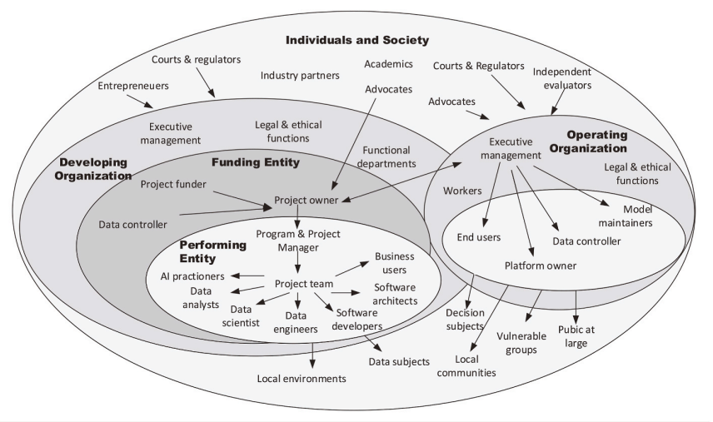
The Complex Network of AI Stakeholders
See Miller (2022)
The group of AI stakeholders functions itself as a complex system of networked actors.

Slide 20
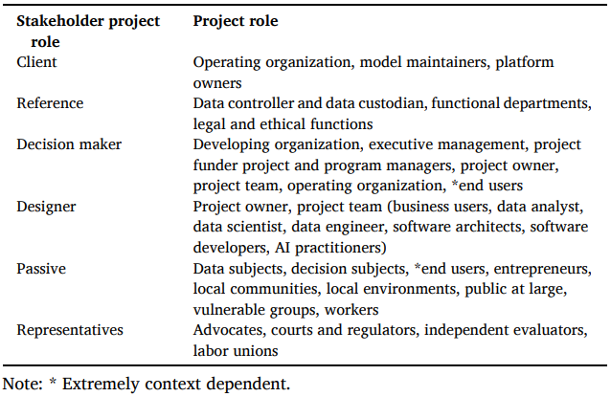
(Some) Stakeholder Roles
See Miller (2022)

Slide 21




High-Level View of the GenAI Lifecycle
As Embedded in Its Value Chain (Wait Unti Next Seminar!)
Develops
Foundation model (e.g., LLM)
Customise Foundation model to suit a given use case
Further fine-tuning of the model
Use of AI tool
Hyperscale technology firm
Tech provider
(deployer one)
Corporate User
(deployer two)
Employees of deployer two
Source: The Institute of International Finance (2024: 8)

Slide 22
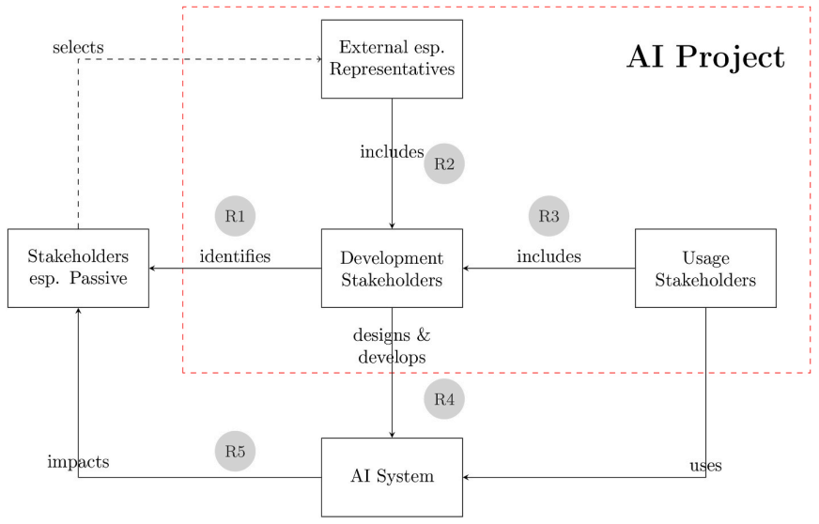
Stakeholder Engagement in the AI Lifecycle
See Miller (2022)
R1: Development stakeholders can identify the groups or interests likely to be affected by the system.
R2: Certain stakeholder representatives can influence decisions throughout the AI lifecycle.
R3: Future deployers can also shape AI systems during design and development.
R4: Designers and decision-makers play a central role throughout the lifecycle, as they are the ones best positioned to balance and account for the interests of multiple stakeholders.
R5: The behaviour of deployers and users is crucial in determining how AI systems affect passive stakeholders in practice.
R2
R1
R3
R4
R5

Slide 23

Questions?

Slide 24
Part Three
The AI Lifecycle in AI Regulations

Slide 25
Mapping the AI Act into the AI Lifecycle
See Gotsch & Puchan (2024)
Gotsch & Puchan (2024) propose an AI Act-compliant lifecycle model structured around five key phases:
Business understanding;
Data management;
ML/AI modelling;
Application development;
Deployment and Operation.

Slide 26
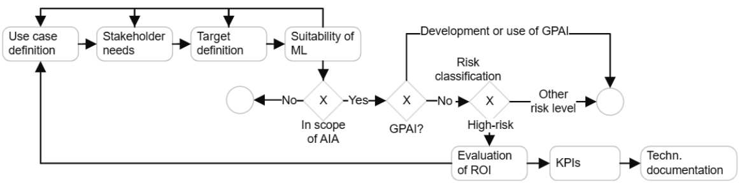
Phase I: Business Understanding
See Gotsch & Puchan (2024: 85-86)
3
1
4
2
Fundamental Steps:
Use Case Definition – Define the AI system’s purpose, objectives, and scope.
AI Act Applicability – Assess whether the system falls within the scope of the AI Act.
Risk Classification – Determine the system’s risk category under the AI Act.
Feasibility & Compliance – Evaluate technical feasibility, costs, and compliance requirements, supported by documentation of key considerations (cf. Art. 11 AIA).

Slide 27
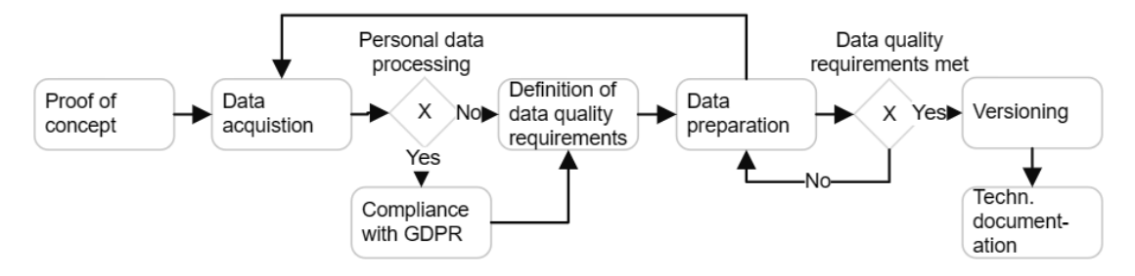
Phase II: Data Management/Governance
See Gotsch & Puchan (2024: 87)
1
4
3
2
5
Fundamental Steps:
Data acquisition – Source data from internal and/or external providers.
GDPR compliance – Ensure compliance when processing personal data.
Defining Data Quality Requirements – Establish quality standards before data preparation begins.
Data Preparation – Prepare the data once quality requirements are met, before moving to AI modelling (Phase III).
Technical Documentation – Document data sources, processing methods, data characteristics, and governance practices (cf. Art. 11 AIA).

Slide 28
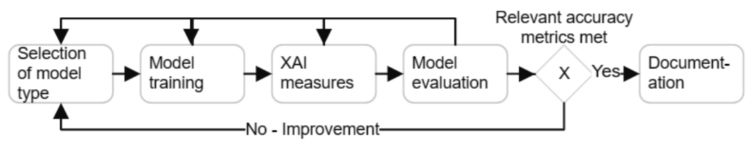
Phase III: AI/ML Modelling
See Gotsch & Puchan (2024: 87-88)
4
1
2
3
5
Fundamental Steps:
Model selection – Choose a model that fits the problem and consider its governance implications, such as opacity and explainability.
Model training – Train the model on relevant datasets and optimise hyperparameters to achieve strong performance.
Interpretability and explainability – Integrate XAI methods where models are not inherently transparent.
Model evaluation (validation) – Test the trained model on an independent dataset to assess its accuracy, reliability, and generalisability.
Technical robustness assurance – Evaluate the model against key performance metrics and regulatory benchmarks, and document the results (cf. Art. 15 AIA).

Slide 29
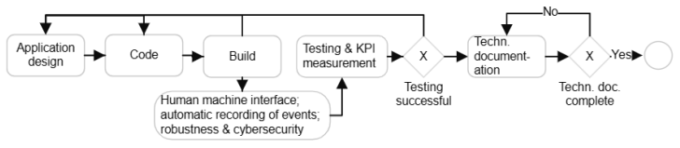
Phase IV: Application Development
See Gotsch & Puchan (2024: 88-90)
1
2
3
Fundamental Steps:
Application design – Develop and code the AI system’s functionalities while integrating key AI Act requirements, including human oversight (Art. 14 AIA), record-keeping (Art. 12 AIA), and technical robustness (Art. 15 AIA).
Testing – Conduct thorough testing to ensure the system’s compliance, reliability, and safety (cf. Art. 9 AIA).
Technical Documentation – Once testing is successfully completed, finalise the relevant sections of the technical documentation (Art. 11 AIA) and prepare the instructions for use (Art. 13 AIA) to support deployers and promote compliance across the AI value chain.

Slide 30
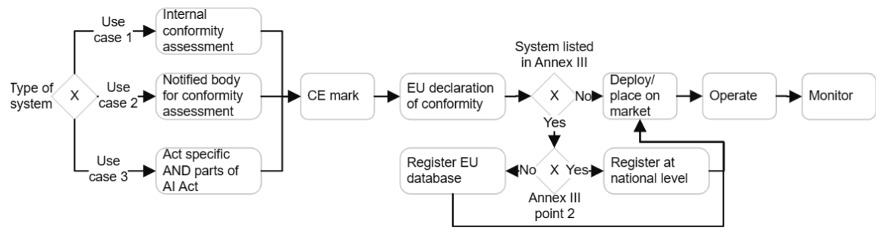
Phase V: System Deployment and Operation
See Gotsch & Puchan (2024: 90-91)
2
4
1
3
Fundamental Steps:
Conformity assessment – High-risk AI systems must undergo a conformity assessment before being placed on the market (Art. 43 AIA).
CE marking – Systems that successfully pass the conformity assessment receive CE marking, signalling compliance with the AI Act and other relevant requirements (Art. 48 AIA).
Database registration – AI systems listed in Annex III AIA must be registered in the relevant EU or national database, depending on the use case (Art. 49 AIA; Annex III, p. 2 AIA).
Deployment and ongoing monitoring – Once deployed, AI systems require continuous monitoring to maintain compliance, mitigate risks, and address emerging issues (see Art. 72 AIA).

Slide 31
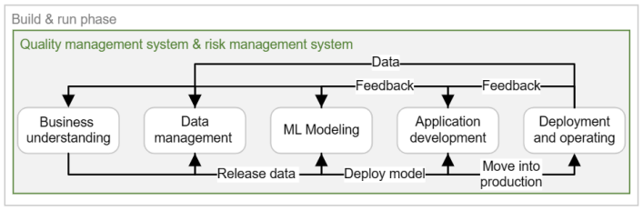
AI Systems as Complex Socio-Technical Systems
See Gotsch & Puchan (2024: 92)
The AI lifecycle is a complex socio-technical system, in which phases, processes, people, data, software, and hardware interact to shape AI governance. Compliance is not a one-off step, but an ongoing and integrated responsibility across the lifecycle. Key cross-cutting AI Act requirements for high-risk AI systems include:
Risk Management (Art. 9 AIA)
Technical Documentation (art. 11 AIA)
Record-keeping (Art. 12 AIA)
Transparency (Art. 13 AIA)
Human Oversight (Art. 14 AIA)
Technical Robustness & Security (Art. 15 AIA)

Slide 32

Questions?

Slide 33
Part Four
In-class Activity

Slide 34
Group Activity
The AI Lifecycle as a Regulatory concept
Work in groups of 3-4 students.
Consider the lifecycle of a large generative AI system such as ChatGPT (e.g., data collection, model development, deployment, and monitoring).
Your Tasks
1. Reflect
Why might a lifecycle approach be useful for regulating and governing such AI system?
2. Apply regulatory theory
How does public regulation theory justify regulating the AI lifecycle?
How does private regulation theory explain the lifecycle’s governance role?
3. Debate
Should regulation of the AI lifecycle rely more on principles or on detailed rules?
📌 Prepare a short reflection to share with the class.

Slide 35

Thank You!
You can reach out at: Alessio.Azzutti@glasgow.ac.uk

